Slide 1

Writing Better Telecom Software with Erlang Style
段先德 2008.12

Slide 2

Contents
Dealing with partial system failure with Erlang process monitor mechanism.
Implementing complex state machine with Erlang selective receive mechanism.
Parsing and packing protocol datagram with Erlang pattern match and bit syntax.

Slide 3
The absence of process
Getting puzzled when exception occurs.
…
int a = cur_usr_count();
float rate = cur_bd() / a;
…
C/C++ Application
cur_usr_count() returns 0 …
…
executing…
process/ thread
OS

Slide 4
Process in Language not OS
Liberate the concurrent object from OS.
C/C++ Application
Erlang
Application
process
Traditional OS
process/ thread
Host OS

Slide 5
Erlang process
Features of Erlang process.
Isolated Memory Space
Exit Signal
Erlang
Process
Unique Identifier
Selective Receive
Lightweight
Message Passing

Slide 6
Erlang view of failure
Process may fail.
If you can’t do what you want to do, die.
Let it crash.
Failure of a process can be observed by some other process.
Let some other process to do the error recovery.
Do not program defensively.

Slide 7
Process link set
Cooperating processes may be linked together.
  spawn_link(…,…,…)
  link(Pid)
When a process terminates, an exit signal is sent to all linked processes, and the termination is propagated.
Exit signals can be trapped and received as messages.
  receive
  {‘EXIT’,Pid,Reason} -> ...
  end

Slide 8
Example: Resource card failure
User process links resource process with itself.
User
Process
Resource
Process
...
ResourcePid = apply_resource(UserID),
link(ResourcePid),
...

Slide 9
Example: Resource card failure
User process will receive the exit signal as normal message when resource process crashes.
User
Process
Resource
Process
Process_flag(trap_exit, true),
...
receive
{‘EXIT’,OldResourcePid,_Reason} ->
return_resource(OldResourcePid),
NewResourcePid = apply_resource(UserID),
...
...
end
But what will happen when user process crashes?...

Slide 10
Process supervisor
Process can be supervised by another process.
  Ref = erlang:monitor(process, Pid)
When the supervised process terminates, an ‘DOEN’ signal is sent to the supervising process.
  {‘DOWN’, Ref, process, Pid, Why}
Supervisors and workers can be layered.
OTP provides the supervisor behaviour.
  -behaviour(supervisor)

Slide 11
Example: User crashes
The “CallMonitor” supervises all “UserProcess”es.
Call
Monitor
“Supervisor”
…
%cur_usr_count() may return 0.
Rate = cur_bd() / cur_usr_count(),
…
User
Process
User
Process
User
Process
executing…
“Workers”
receive
{‘DOWN’,UserRef,process, UserPid, Why} ->
wirte_service_log(userdown,user_info(UserRef),Why),
NewUserPid = active_user(UserID, user_info(UserRef)),
...
...
end

Slide 12
Contents
Dealing with partial system failure with Erlang process monitor mechanism.
Implementing complex state machine with Erlang selective receive mechanism.
Parsing and packing protocol datagram with Erlang pattern match and bit syntax.

Slide 13
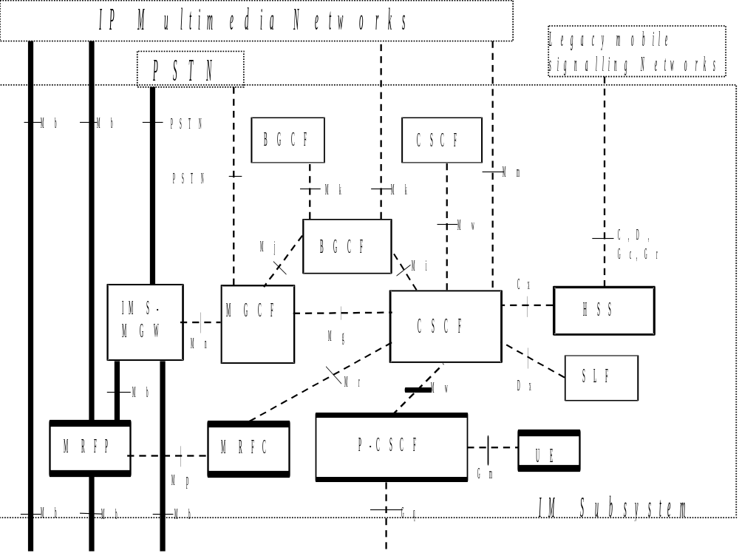
Telecom system
E.g. the IMS architecture:

Slide 14
Very complex software
Asynchronous programming is very difficult.
Constructed by loosely coupled
components: Delay issue,
Partial system failure.
State space
explosion
Stateful multi-way communication:
Asynchronous message,
Unordered message arrival.
Message driven service model:
Waiting a specified message.

Slide 15
Claims
Ability to implement complex state machine well.
1
2
3
State encapsulation:
Blocking the thread of control while waiting some
message to keep the
logical flow intact.
Message reordering:
Filtering messages with implicit buffering.
RPC:
Converting asynchronous calls to synchronous calls.
“Selective Receive” helps…

Slide 16
Erlang Selective Receive
receive
{foo, X} -> ...
{bar, X} -> ...
after 1000 -> ... % handle timeout
end
Mailbox and “save queue”.
Patterns and guards let you select which messages you currently want to handle.
  Any other messages will remain in the mailbox
The receive-clauses are tried in order.
  If no clause matches, the next message is tried
If no message in the mailbox matches, the process suspends, waiting for a new message.
The process will wait until a matching message arrives, or the time-out limit is exceeded.

Slide 17
Selecting unordered messages
Sender1
receive
m1 -> io:format(“Got m1”)
end,
receive
m2 -> io:format(“Got m2”)
end
m1
Receiver
Sender2
m2
Using selective receive, we can choose which messages to accept, even if they arrive in a different order.
In this example, P2 will always print "Got m1!" before "Got m2!", even if m2 arrives before m1.
  m2 will be ignored until m1 has been received

Slide 18
Example: Play Tone for Caller
Other
Process
User
start_tone
Tone
Service
Other_Msgs
start_tone_ok
start_tone_fail
offhook
onhook
Subscriber
“User” received a “offhook” event from its subscriber while being in ‘idle’ state. Yes, as a caller.
You should send a “start_tone” message to “ToneService” to play dial tone.
What will happen before receiving the response?

Slide 19
Example: Non-blocking
idle(ToneServicePid) ->
receive
{offhook, Subscriber} ->
Ref = make_ref(),
ToneServicePid ! {start_tone, dailtone, Ref, self()},
await_start_tone(Ref, Subscriber);
… %% handle other significative messages.
end
await_start_tone(Ref, Subscriber) ->
receive
{start_tone_ok, Ref} ->
getting_first_digit();
{start_tone_fail, Ref} ->
await_on_hook(Subscriber);
… %% handle other significative messages.
end
There must be an “await_start_tone” state.
And having to handle every message in that state, which means more complexity.

Slide 20
Example: Blocking
idle(ToneServicePid) ->
receive
{offhook, Subscriber} ->
Ref = make_ref(),
ToneServicePid ! {start_tone, dailtone, Ref, self()},
receive %% suspend the process to wait the response
{start_tone_ok, Ref} ->
getting_first_digit();
{start_tone_fail, Ref} ->
await_on_hook(Subscriber)
end;
… %% handle other significative messages.
end
Reducing the number of “waiting response” states, which means less complexity.
Other messages are buffered by the order thy arrive, and will be handled once the process resumes.

Slide 21
Contents
Dealing with partial system failure with Erlang process monitor mechanism.
Implementing complex state machine with Erlang selective receive mechanism.
Parsing and packing protocol datagram with Erlang pattern match and bit syntax.

Slide 22
Bin-Protocol & Txt-Protocol
Bin-Protocol: The information is described and carried in the structured binary data flow.
  - effective.
  - easy to pack and parse.
  - unreadable.
Txt-Protocol: The information is described and carried in the text string.
  - need more bandwidth.
  - not easy to pack and parse.
  - readable.

Slide 23
Erlang Pattern Match
Pattern matching is the act of comparing a pattern with a ground term. If the pattern is a primitive pattern and the ground terms are of the same shape, and if the constants occurring in the pattern occur in the ground term in the same places as in the pattern then the match will succeed, otherwise it will fail.
Making reliable distributed systems in the presence of software errors
Joe Armstrong
Message dispatching by sequential trying to match.
Variable binding.

Slide 24
Example: Shape
-module(shape).
-export([area/1, perimeter/1]).
area({circle, R}) -> 3.14 * R * R;
area({square, Side}) -> Side * Side;
area({rectangle, A, B}) -> A * B.
perimeter({circle, R}) -> 3.14 * 2 * R;
perimeter({square, Side}) -> Side * 4;
perimeter({rectangle, A, B}) -> 2 * (A + B).
Add a shape type(e.g. triangle).
Add a method(e.g. draw it).
Do you remember how to do this in PO or OO?

Slide 25
Erlang Binary and Bit Syntax
Binaries are memory buffers designed for storing untyped data. Binaries are used primarily to store large quantities of unstructured data and for efficient I/O operations.
The bit syntax provides a notation for constructing binaries and for pattern matching on the contents of binaries.
Binary and Bit Syntax will greatly simplify the Bin-Protocol parsing and packing operation.

Slide 26
Example: LAPD Frame
%%%% parse lapd-frame %%%%
getframeinfo(<<_Sapi:6, _CRbit:1, 0:1, _Tei:7, 1:1, NS:7, 0:1,
NR:7, PFbit:1,Data/binary>>)->
#i_frame{pfbit=PFbit, ns=NS, nr=NR, data=Data};
getframeinfo(<<_Sapi:6, CRbit:1, 0:1, _Tei:7, 1:1, 1:8, NR:7,
PFbit:1>>) when CRbit == ?PeerCmd ->
#rr_frame{crflag=peer_command, pfbit=PFbit, nr=NR};
getframeinfo(<<_Sapi:6, CRbit:1, 0:1, _Tei:7, 1:1, 1:8, NR:7,
PFbit:1>>) when CRbit == ?PeerRsp ->
#rr_frame{crflag=peer_response, pfbit=PFbit, nr=NR};
…
%%%% build lapd-frame %%%%
build_sabme(#dlci{sapi=Sapi, tei=Tei}) ->
<<Sapi:6, ?SelfCmd:1, 0:1, Tei:7, 1:1, 3:3, 1:1, 15:4>>.
build_disc(#dlci{sapi=Sapi, tei=Tei}) ->
<<Sapi:6, ?SelfCmd:1, 0:1, Tei:7, 1:1, 2:3, 1:1, 3:4>>.
build_ui(#dlci{sapi=Sapi, tei=Tei}, Data) ->
<<Sapi:6, ?SelfCmd:1, 0:1, Tei:7, 1:1, 0:3, 0:1, 3:4,
Data/binary>>.
build_ua(#dlci{sapi=Sapi, tei=Tei}, PFbit) ->
<<Sapi:6, ?SelfRsp:1, 0:1, Tei:7, 1:1, 3:3, PFbit:1, 3:4>>.
…

Slide 27
Thank you
E-mail : duan.xiande@gmail.com
IM : sanderisme@hotmail.com

